Slide 1
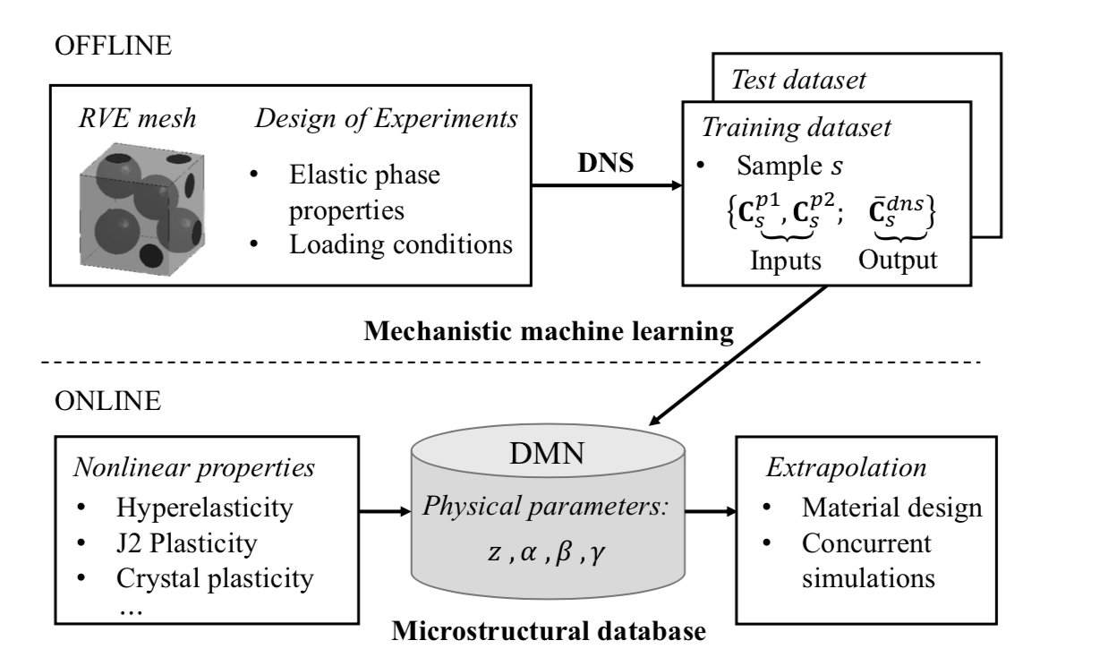
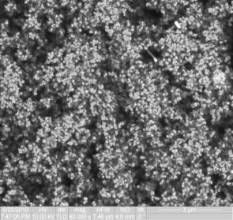
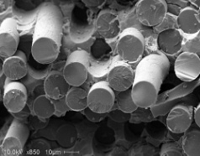
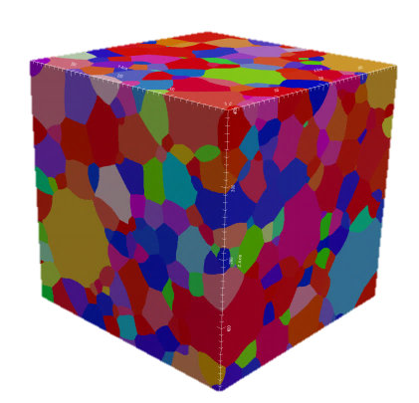

Slide 2
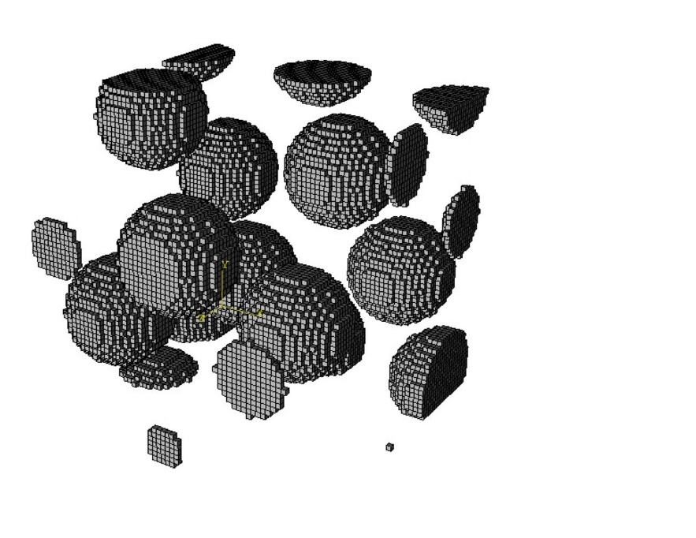
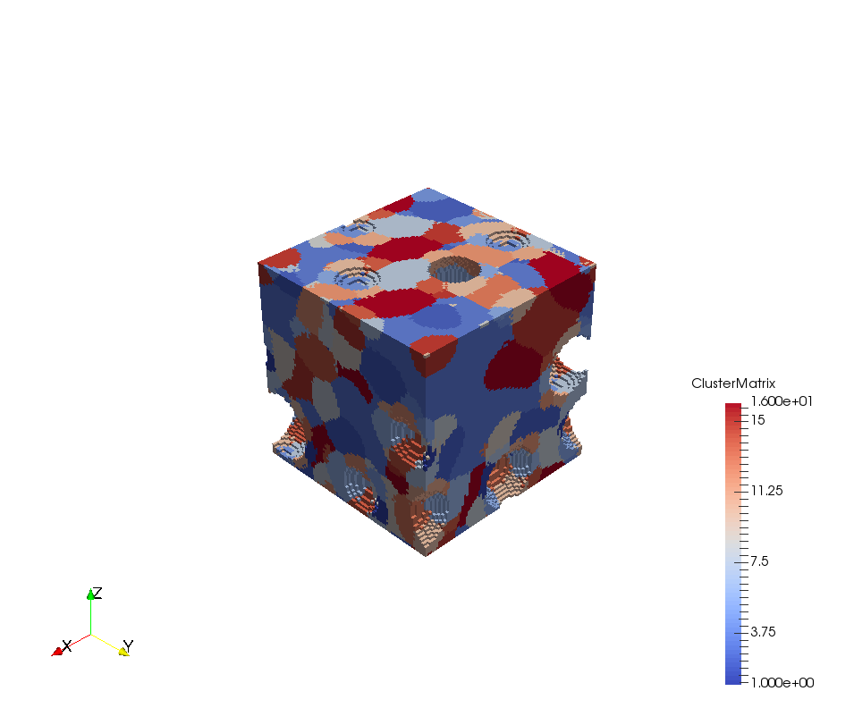
High-fidelity RVE
(DNS)
Offline or training stage (SCA)
Reduced Order Model
1) Domain decomposition (k-means clustering): find material clusters.
2) Compute the interaction tensors based on the Green’s function.
Online or predictive stage (SCA)
Self-consistent scheme for reduced Lippman-Schwinger equation.
Validation

Slide 3
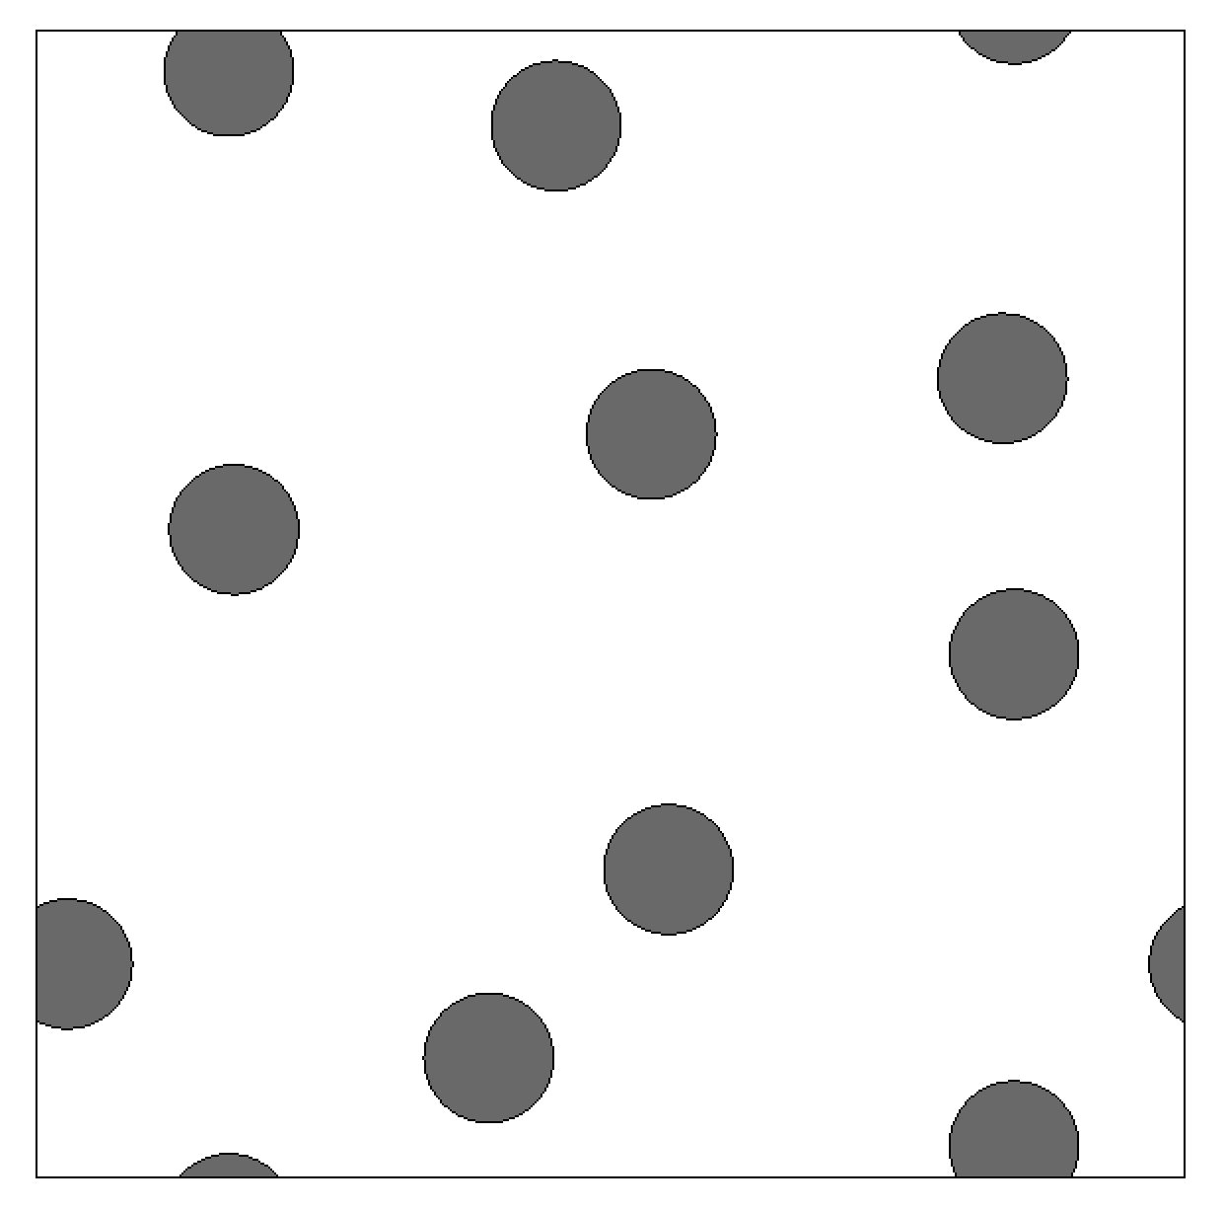
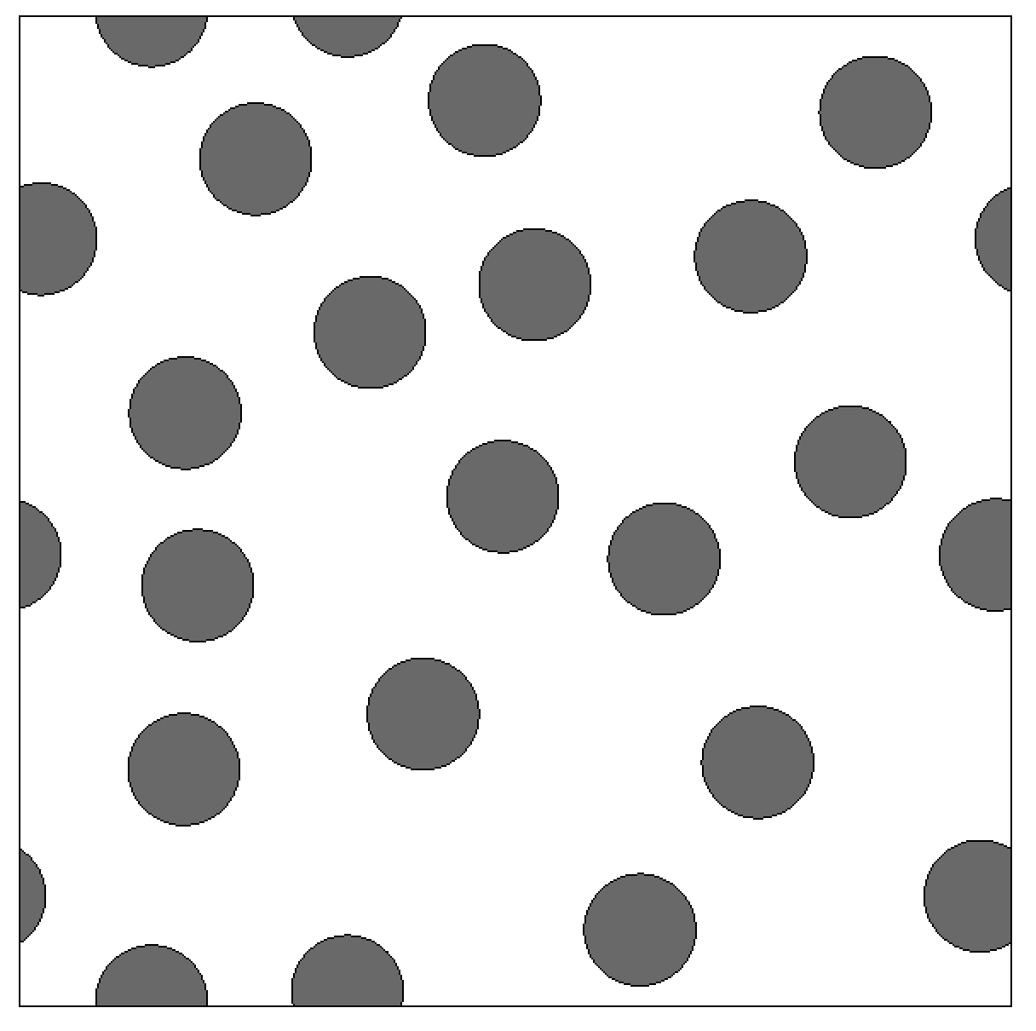
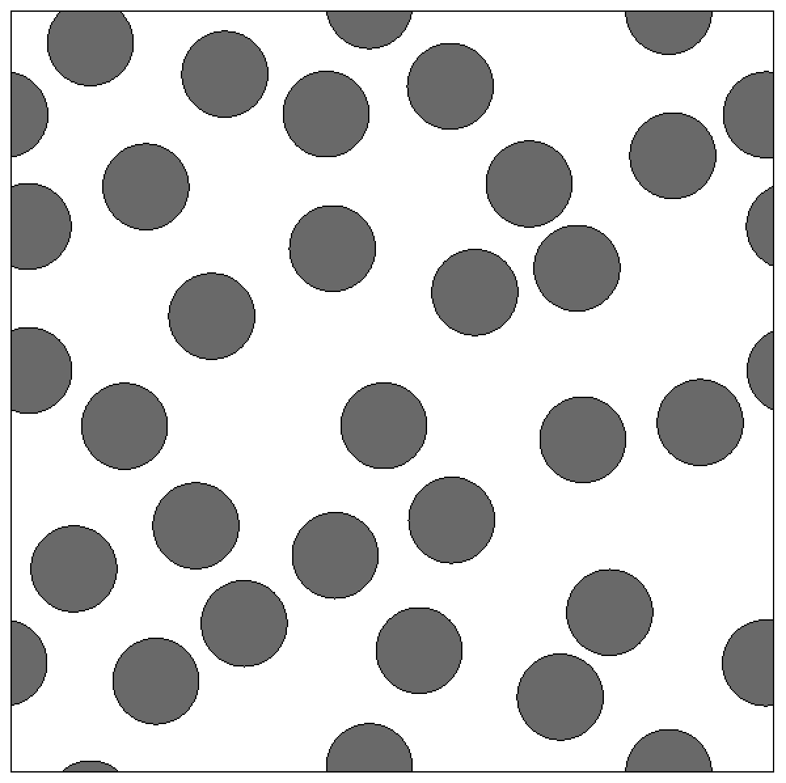
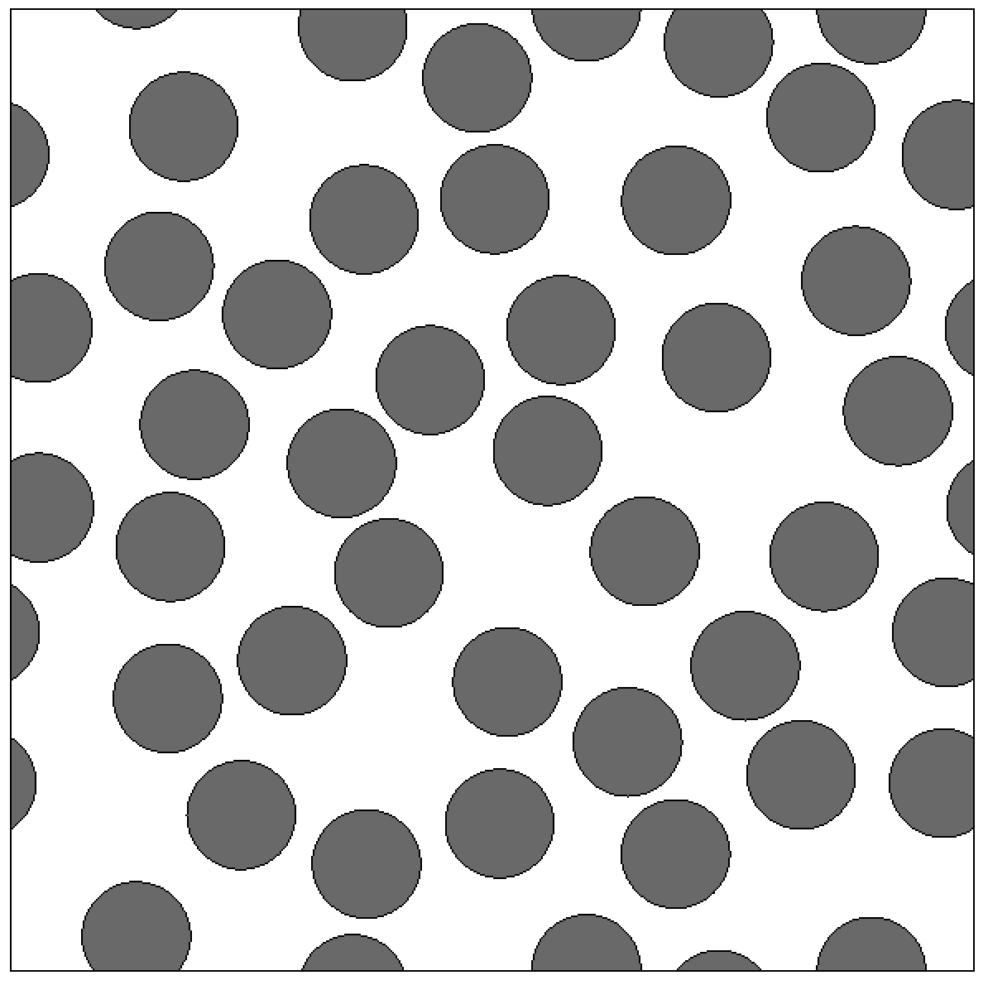
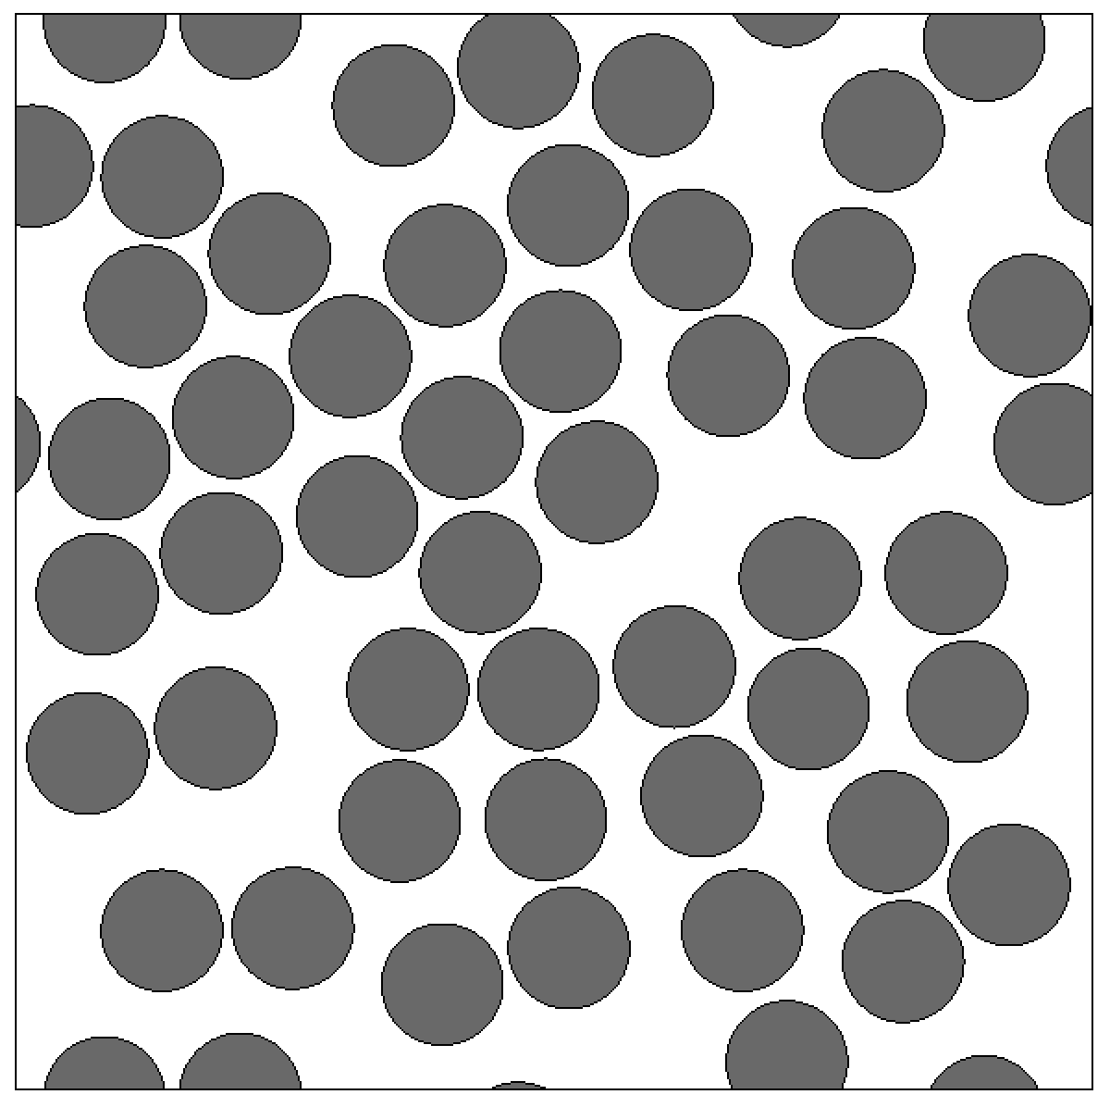
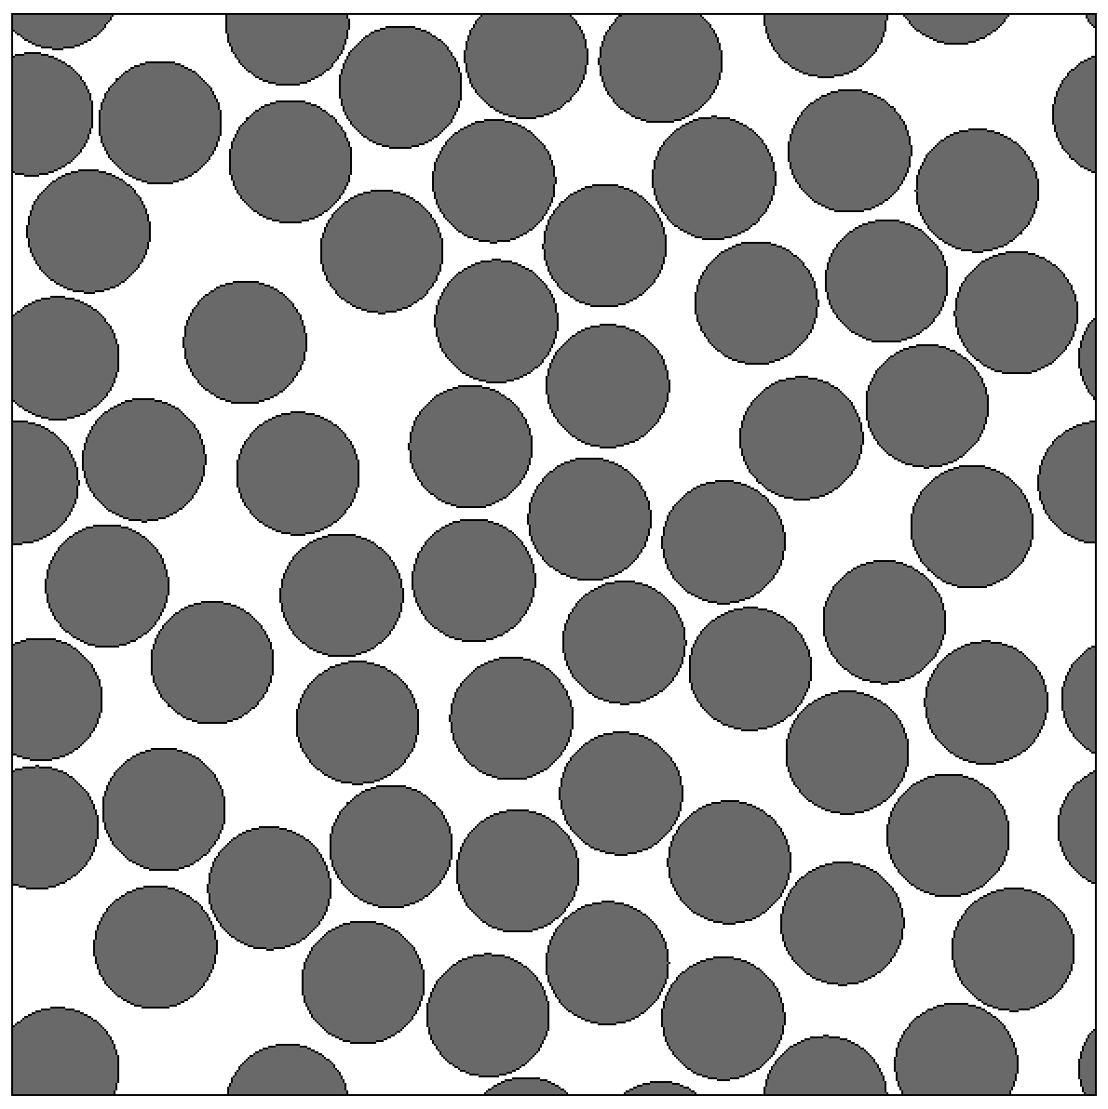
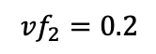
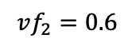
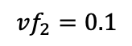
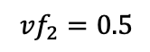
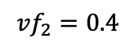
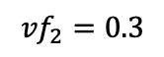
$${vf}_{2}=0.1$$
$${vf}_{2}=0.2$$
$${vf}_{2}=0.3$$
$${vf}_{2}=0.4$$
$${vf}_{2}=0.5$$
$$vf_{2}=0.6$$

Slide 5
RVE Preprocessing tools: design of experiment
Material properties
+
RVE Geometry
+
Boundary conditions
& Loading paths
Virtual Experiments on RVE
FEM in 2D&3D
Periodic BC, Displacement BC
Non-matching meshes
Homogenization/Averaging
RVE package for analysis and homogenization in LS-DYNA
Material informatics
Virtual material testing data
Machine learning for material modeling
Experimental testing data

Slide 6
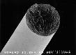
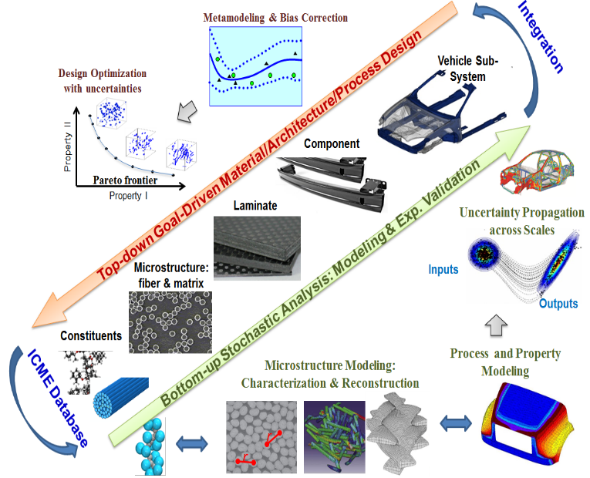
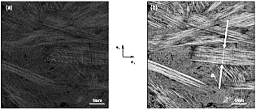

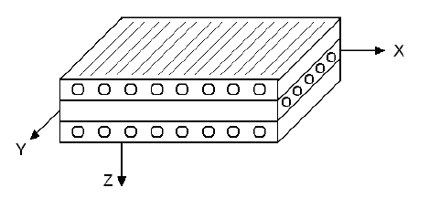
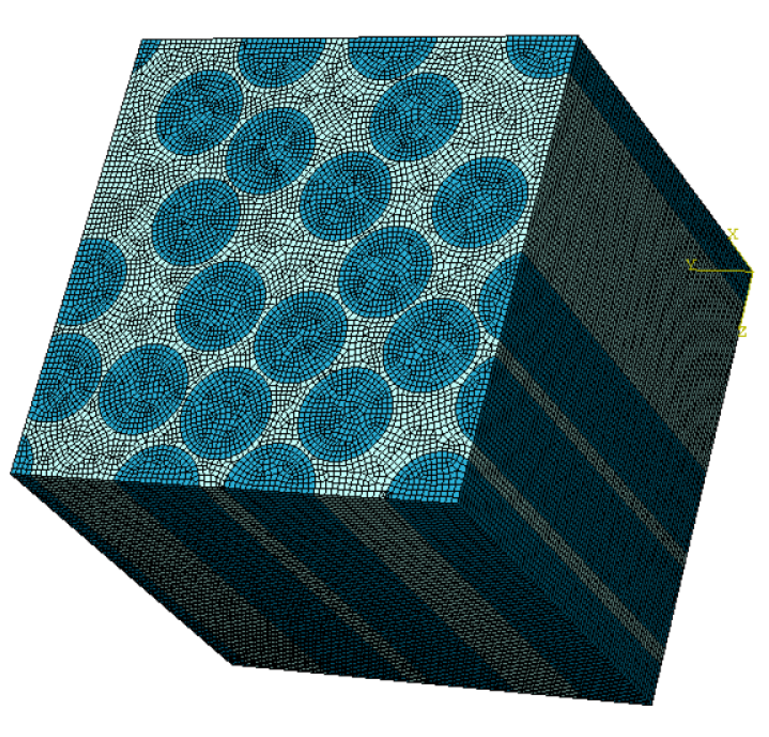
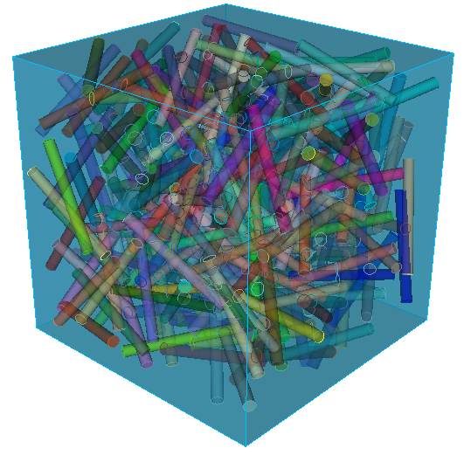
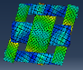
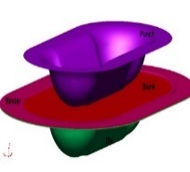
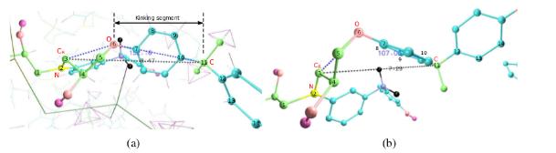
Nanoscale
Microscale
Mesoscale
Macroscale
Macroscale
Constituent properties
Aligned fibers
Complex fiber orientations
Lay-ups/ Laminates
Final part
7 µm
60 µm
1 mm
20 mm
50 cm
70 µm
30 mm
5 mm
0.6 m
nm
µm
mm
cm
m

Slide 7
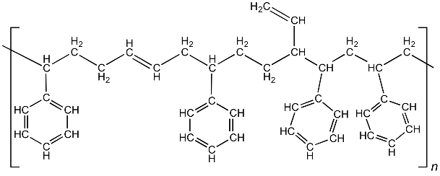
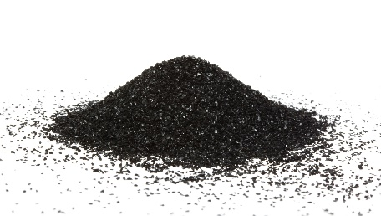
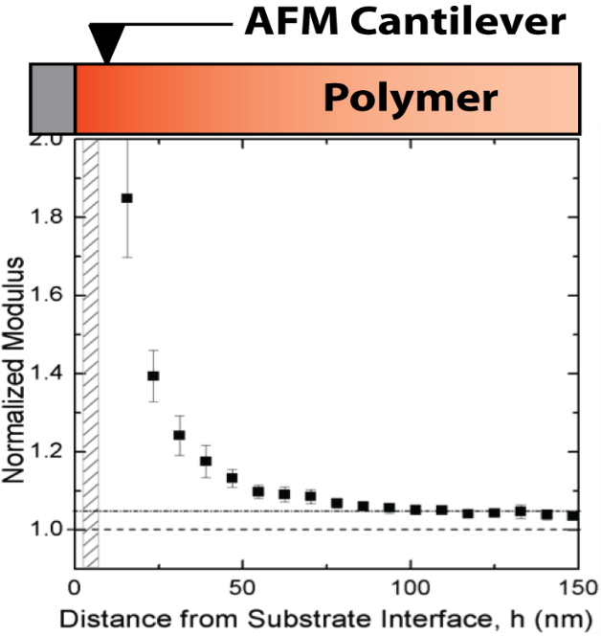

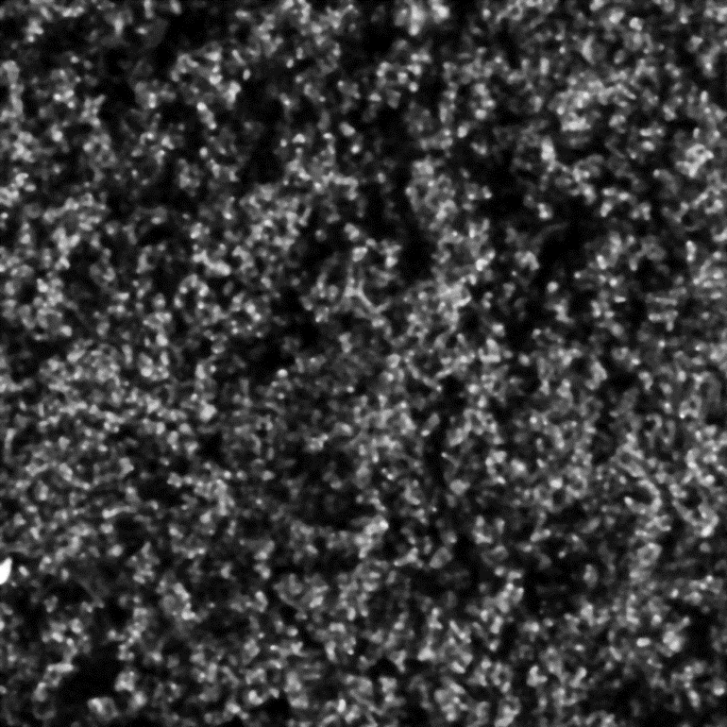
Bulk polymer
Nano-fillers
Mechanical interphase
+
Interphase
styrene butadience rubbers (SBR)
Carbon black (~30nm)
Particle 2
ç
Particle
1
Polymer nanocomposite (PNC)
SEM
Cite: Zhang et al. Macromolecule 2017

Slide 8
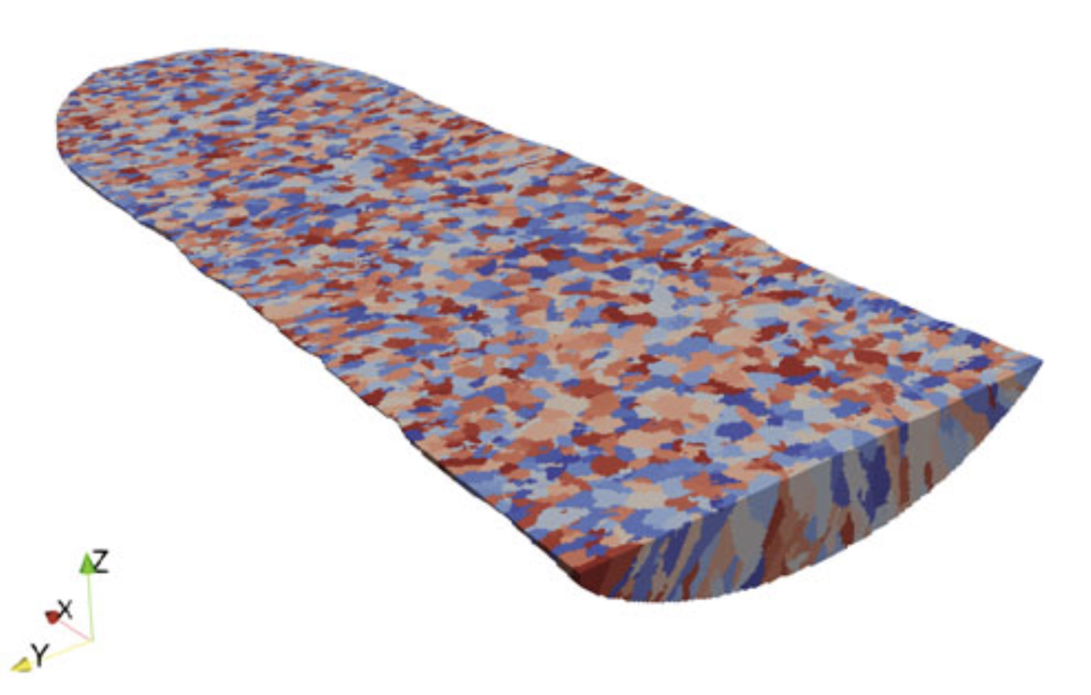
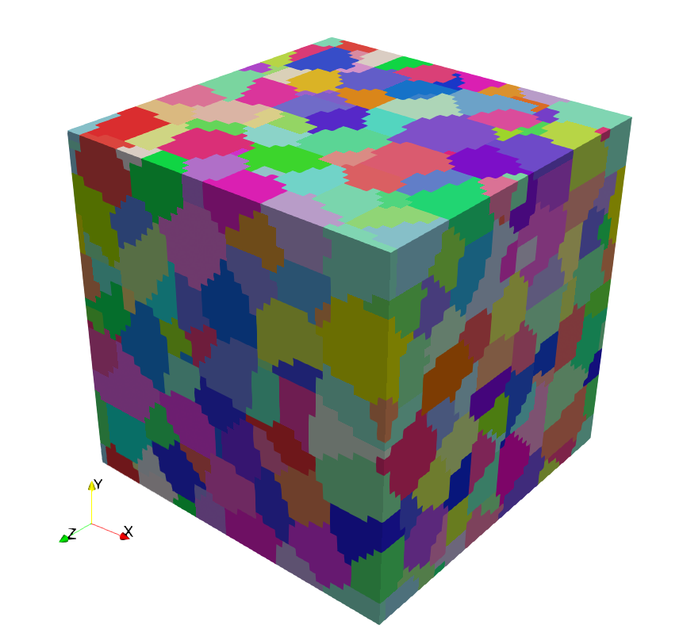
Manufacturing process
Structure models
Powder-scale simulation
Part-scale thermal-mechanical simulation
Solidification:
Reheating: Grain Coarsening
Temperature
Solid phase transformation
Liquidus temp
Property predictions
Solidus temp
Re-crystalization temp
Time

